Slide 1
Chapter 3
Entity Relationship (E-R) Modeling

Slide 2
In this chapter, you will learn:
What a conceptual model is and what its purpose is
The difference between internal and external models
How internal and external models serve the database design process
How relationships between entities are defined and refined, and how such relationships are incorporated into the database design process
How ERD components affect database design and implementation

Slide 3
Basic Modeling Concepts
Art and science
Good judgment coupled with powerful design tools
Models
“Description or analogy used to visualize something that cannot be directly observed” Webster’s Dictionary

Slide 4
Basic Modeling Concepts
Data Model
Relatively simple representation of complex real-world data structures
Basic tools for database design
Abstraction
Good database design starts with a good design of data model.

Slide 5
Basic Modeling Concepts
Data Model
Different views of data and different concerns
Communication is needed.
Impacts on overall management system and policy, as well as decision make.
Blueprint, architecture, framework

Slide 6
Data Models: Degrees of Data Abstraction
Three different models (according to the degree of abstract)
Conceptual model
Global view of data
Basis for identification and description of main data items
Internal model
Representation of database as seen by DBMS
Adapts conceptual model to specific DBMS
External model
Based on internal data model
Users’ views of data environment
Provides subsets of internal view
Physical model
Lowest level of abstraction
Describe the ways data being stored

Slide 7
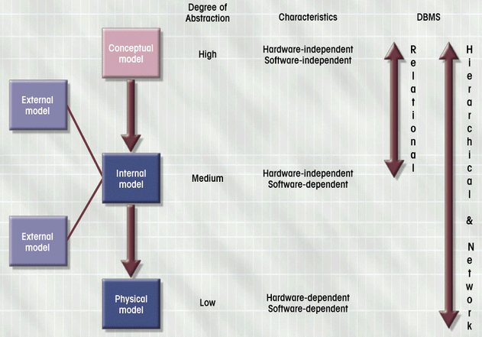

Slide 8
The Entity Relationship (E-R) Model
Represents conceptual view
Main Components
Entities
Corresponds to entire table, not row
Represented by rectangle
Attributes
Relationships

Slide 9
What Should an Entity Be?
SHOULD BE:
An object that will have many instances in the database
An object that will be composed of multiple attributes
An object that we are trying to model
SHOULD NOT BE:
A user of the database system
An output of the database system (e.g. a report)

Slide 10
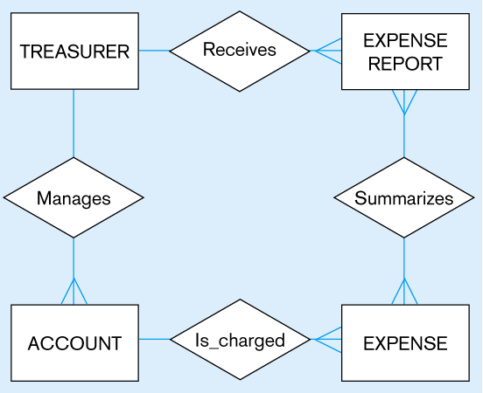
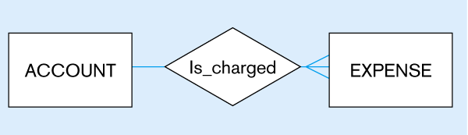
Figure 3-4
Inappropriate entities
System user
System output
Appropriate entities

Slide 11
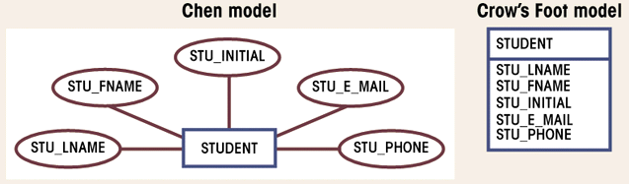
Attributes
Characteristics of entities
Domain is set of possible values
Primary keys underlined
Figure 3.6

Slide 12
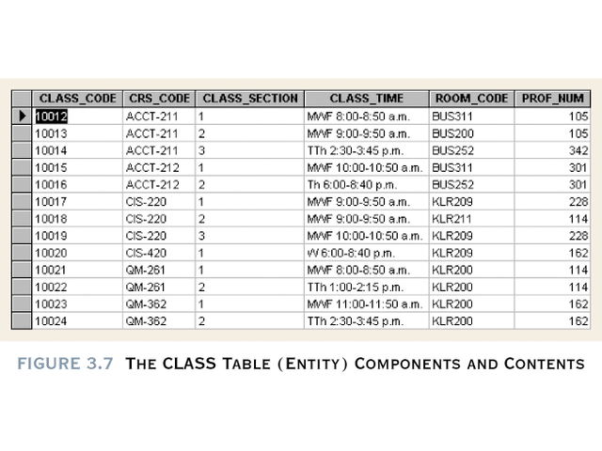

Slide 13
Simple
Cannot be subdivided
Age, sex, marital status
Composite (avoided)
Can be subdivided into additional attributes
Address into street, city, zip
Single-valued
Can have only a single value
Person has one social security number
Multi-valued (avoid) in RDBMS
Can have many values
Person may have several college degrees
How to avoid? (see next slide)
Derived
Can be derived with algorithm (Age can be derived from date of birth)
Need to be stored

Slide 14
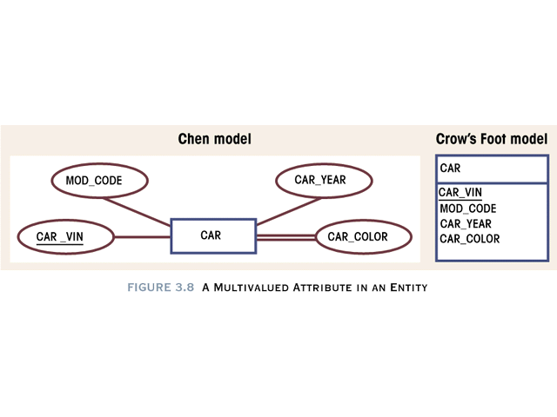

Slide 15
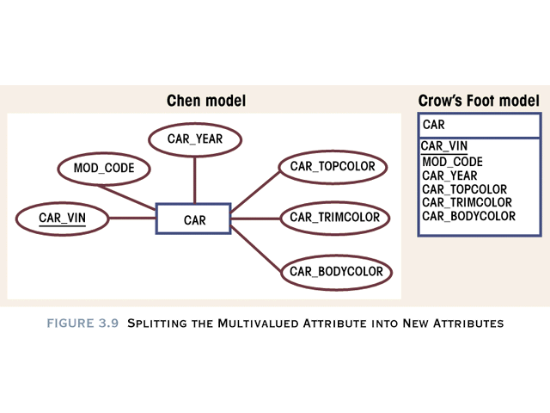

Slide 16
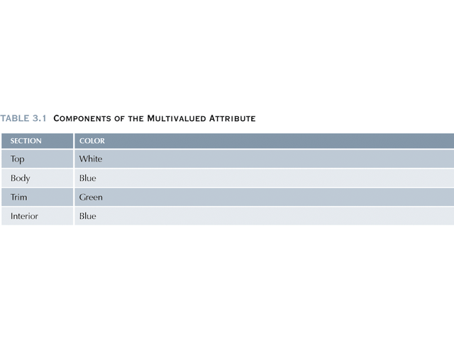

Slide 17
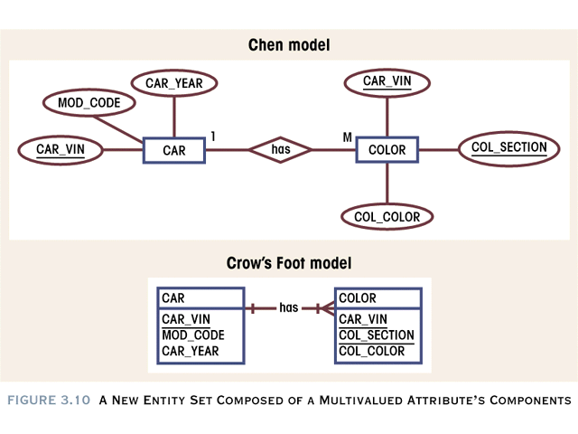

Slide 18
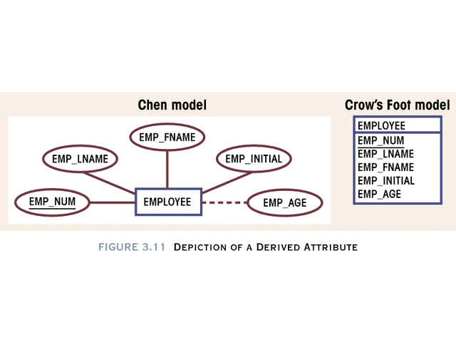

Slide 19
Relationships
Association between entities
Connected entities are called participants
Operate in both directions
Connectivity describes relationship classification
1:1, 1:M, M:N
Cardinality
Expresses number of entity occurrences associated with one occurrence of related entity

Slide 20
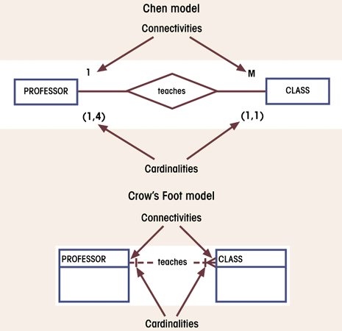
Connectivity and Cardinality in an ERD
Figure 3.12

Slide 21
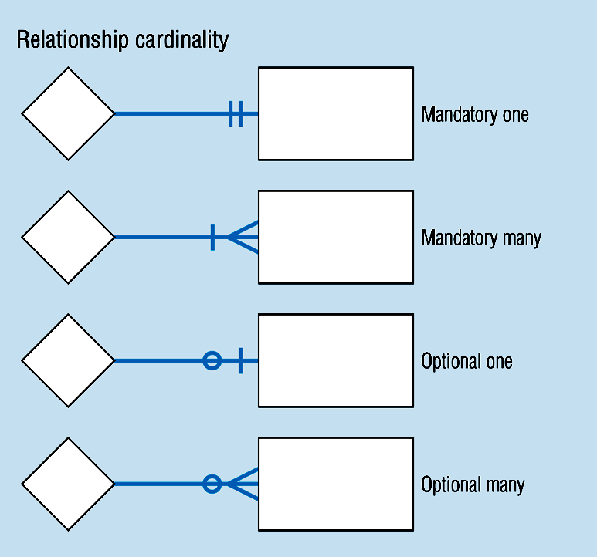
Relationship Participation

Slide 22
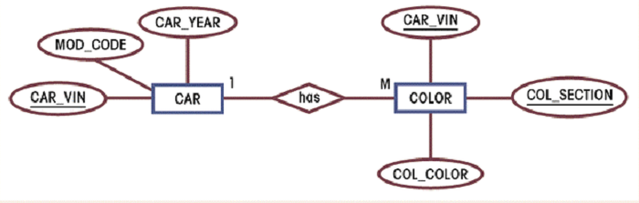
Relationship Strength
Existence dependence
Entity’s existence depends on existence of related entities
Existence-independent entities can exist apart from related entities
Example:

Slide 23
Relationship Strength
Weak (non-identifying)
One entity is existence-independent on another
PK of related entity doesn’t contain PK component of parent entity
Strong (identifying)
One entity is existence-dependent on another
PK of related entity contains PK component of parent entity

Slide 24
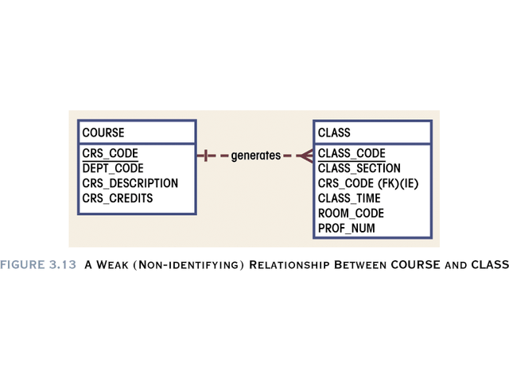

Slide 25
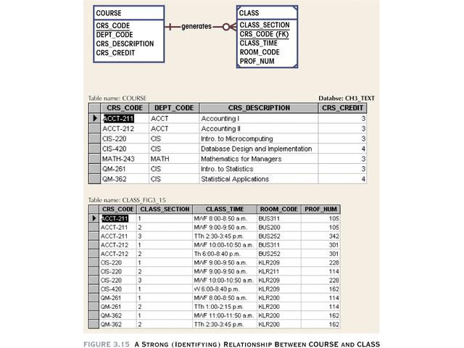

Slide 26
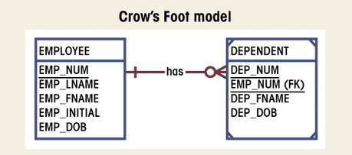
Weak Entity
Existence-dependent on another entity
Has primary key that is partially or totally
derived from parent entity
Figure 3.19

Slide 27
Relationship Degree
Indicates number of associated entities
Unary
Single entity
Recursive
Exists between occurrences of same entity set
Binary
Two entities associated
Ternary
Three entities associated

Slide 28
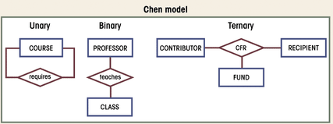
Three Types of Relationships
Figure 3.21

Slide 29
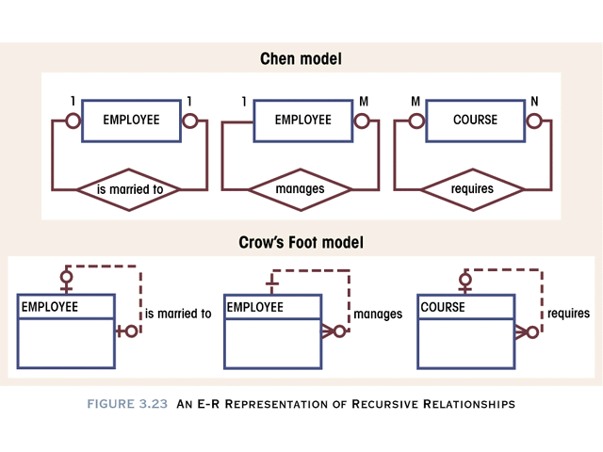

Slide 30
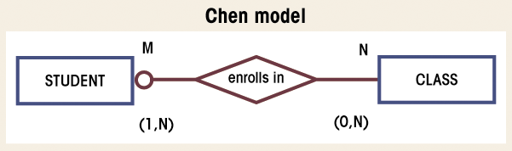
Composite Entities
Used to ‘bridge’ between M:N relationships
Bridge entities composed of primary keys of each entity needing connection
Figure 3.30

Slide 31
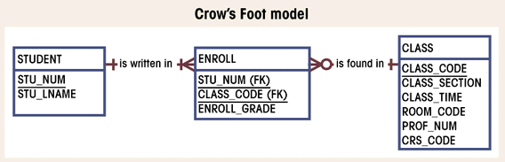
Composite Entities (con’t.)
Figure 3.31

Slide 32
Entity Supertypes and Subtypes
Generalization hierarchy
Depicts relationships between higher-level supertype and lower-level subtype entities
Supertype has shared attributes
Subtypes have unique attributes
Disjoint relationships
Unique subtypes
Non-overlapping
Indicated with a ‘G’
Overlapping subtypes use ‘Gs’ Symbol

Slide 33
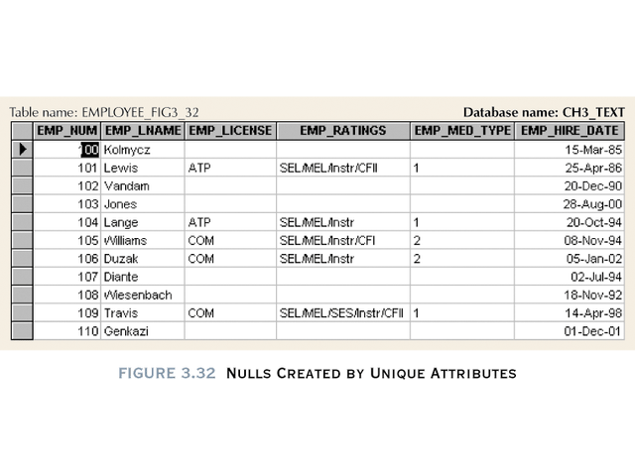

Slide 34
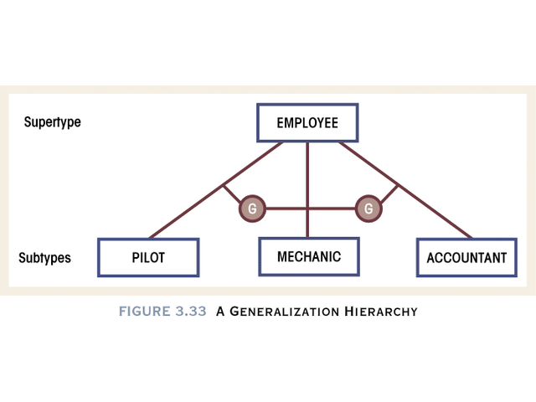

Slide 35
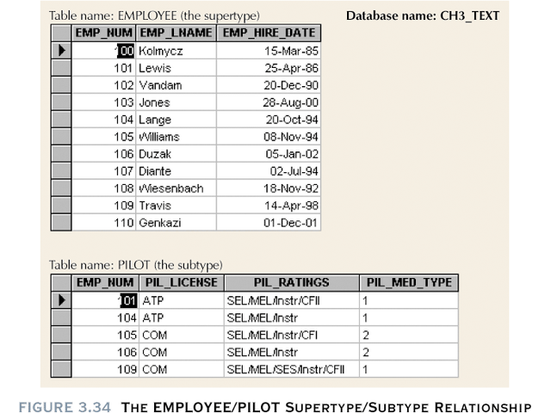

Slide 36
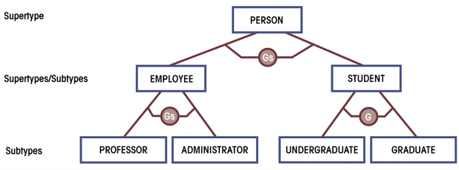
Generalization Hierarchy with Overlapping Subtypes
Figure 3.35

Slide 37
Developing an E-R Diagram
Iterative Process
Step1: General narrative of organizational operations developed
Step2: Basic E-R Model graphically depicted and reviewed
Step3: Modifications made to incorporate newly discovered E-R components
Repeat process until designers and users agree E-R Diagram complete

Slide 38
Supertype/Subtype Relationship in an ERD

Slide 39
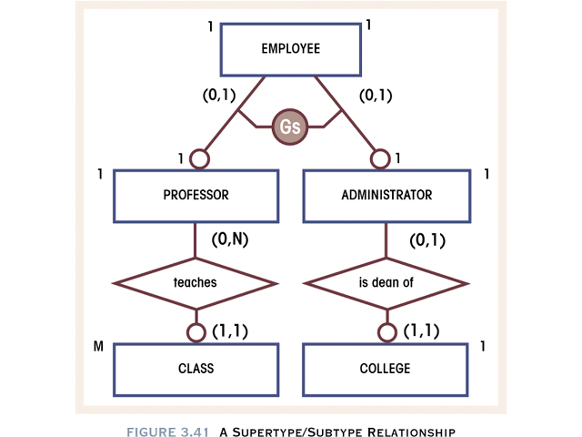

Slide 40
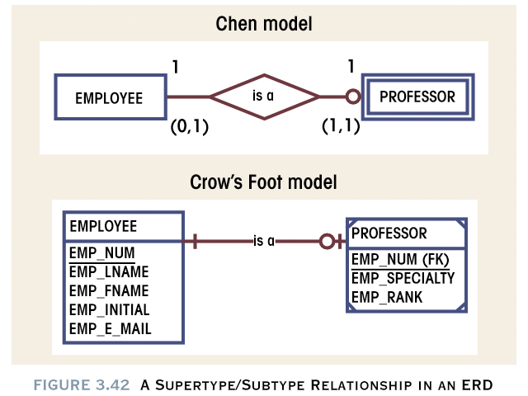

Slide 41
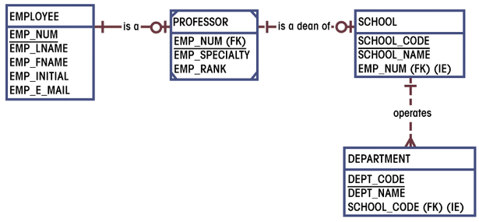
First ERD Segment Established
Figure 3.43

Slide 42
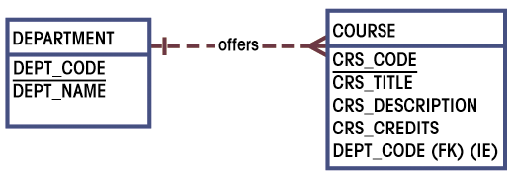
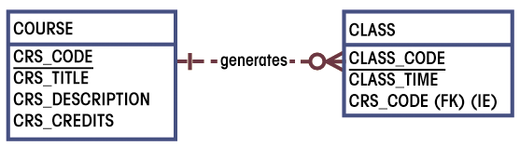
Second and Third ERD Segments Established

Slide 43
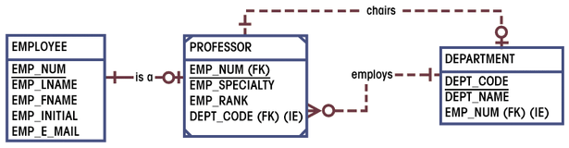
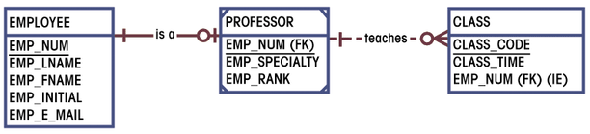
Fourth and Fifth ERD Segments Established

Slide 44
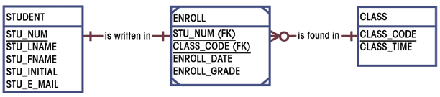
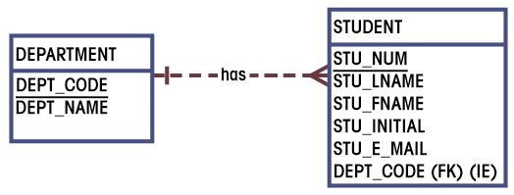
Sixth and Seventh ERD Segments Established

Slide 45
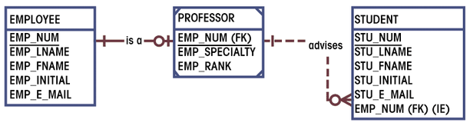
Eighth ERD Segment Established

Slide 46
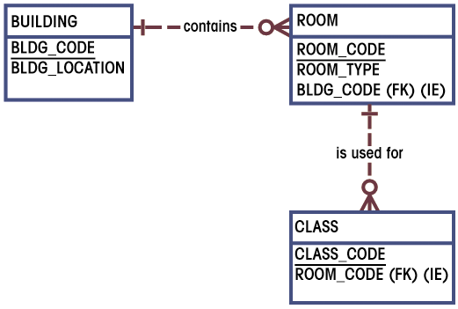
Ninth ERD Segment Established
Figures 3.51

Slide 47
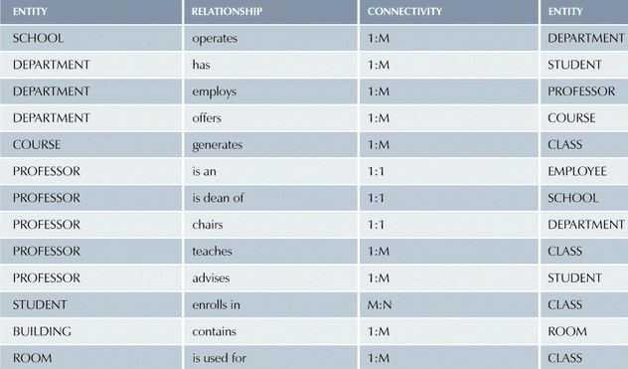
Components of E-R Model
Table 3.2

Slide 48
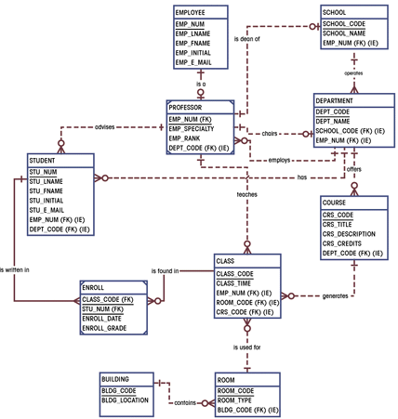
Completed ERD
Figure 3.52

